Slide 1


Model Setup I Overview
UNCLASSIFIED
Barry Bunch, DE, PE and Todd Steissberg, PhD, PE
U.S. Army Engineer Research and Development Center, Environmental Laboratory
CE-QUAL-W2 Workshop
August 16 - 18, 2022
Environmental Systems
Modeling Team
UNCLASSIFIED

Slide 2

Outline
Background
Definition of problem
Required Information
Bathymetry
Flow
Meteorology
Observations
Other
Output
Detroit Dam, Oregon
Notes:
Photo source: https://upload.wikimedia.org/wikipedia/commons/6/60/USACE_Detroit_Dam_Oregon.jpg

Slide 3
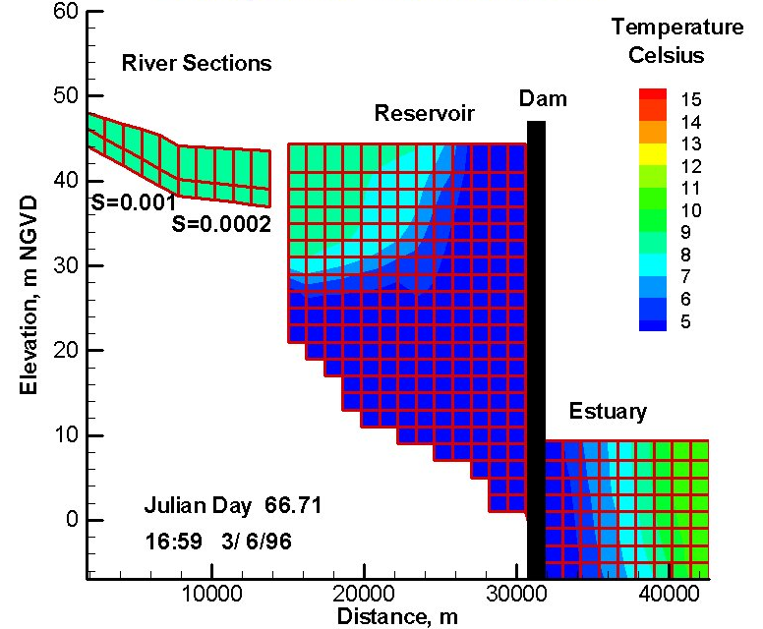
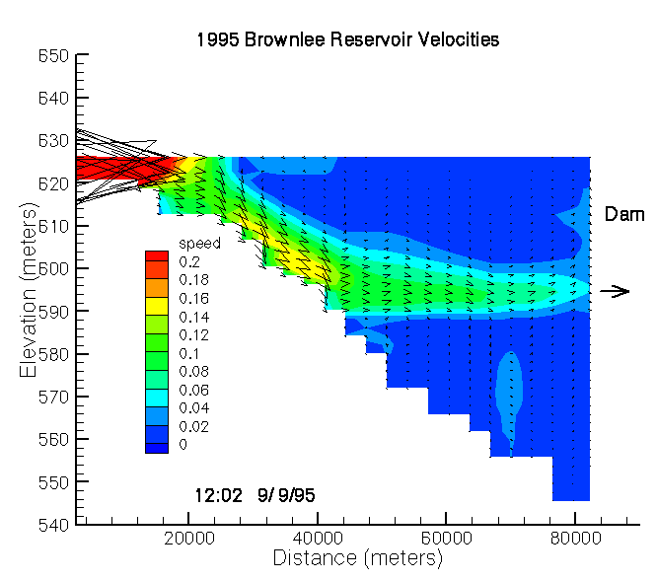
Background
Setting up a computational model is an effort to create a computational approximation of a real system.
A model enables one to investigate past behavior or future conditions with regard to changes in conditions.
Approximations, simplifications, and omissions are necessary but must be balanced with regards to the model’s ability to accurately capture the behavior of the real system.

Slide 4
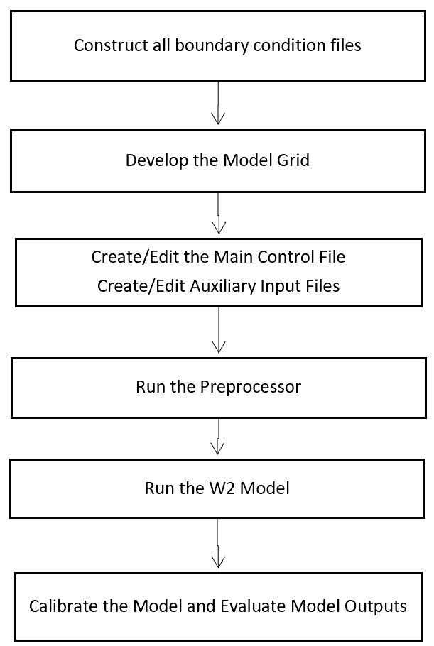
How to Set Up and Run a Model Application

Slide 5

Definition of Problem
What are water quality issues occurring in system that warrant a model?
Are they the result of:
Flow alterations?
Operations?
Boundary Loadings?
Intermediate loadings?
Meteorology?
Altered system conditions?
Anticipated future changes in any of above?
Other?
What information is required to set up a model to capture the behavior in question?
Source:
https://www.erdc.usace.army.mil/Media/Images/igphoto/2002471393/

Slide 6
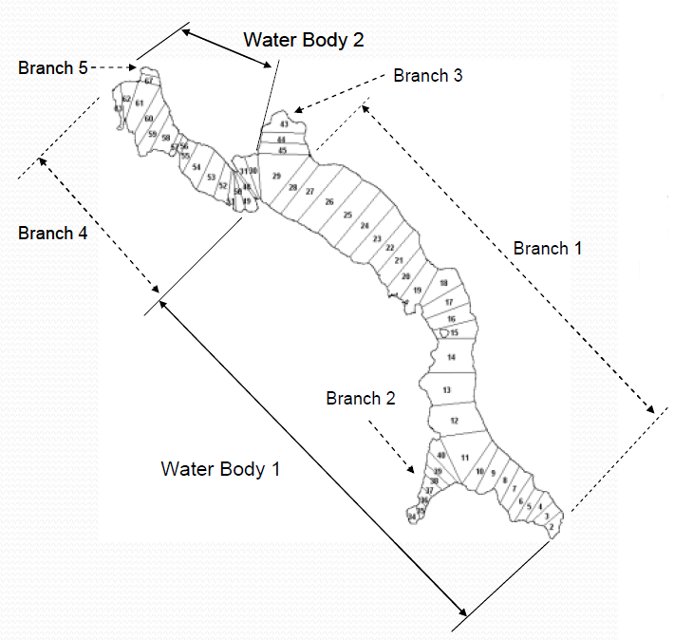
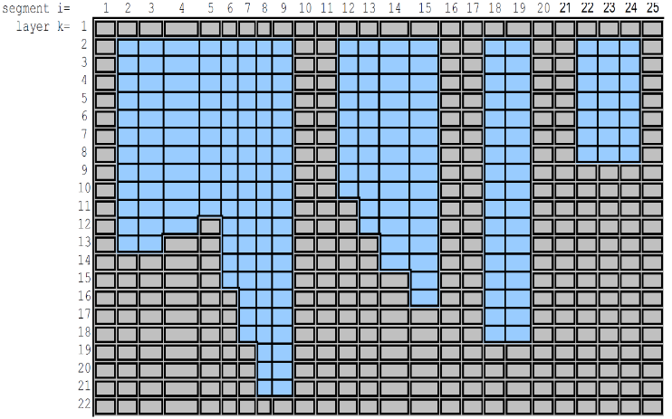
Bathymetry
Defines the physical structure of the natural system for the model
Sources
Sediment range surveys
Cross Sections
Pre-impoundment surveys for reservoirs
Extent
All of area of concern and beyond
Reaching upstream to control point
Resolution
Horizontal (across system) – meters
Longitudinal (along system) – 10s or meters or more
Vertical (through water column) – meter or less

Slide 7
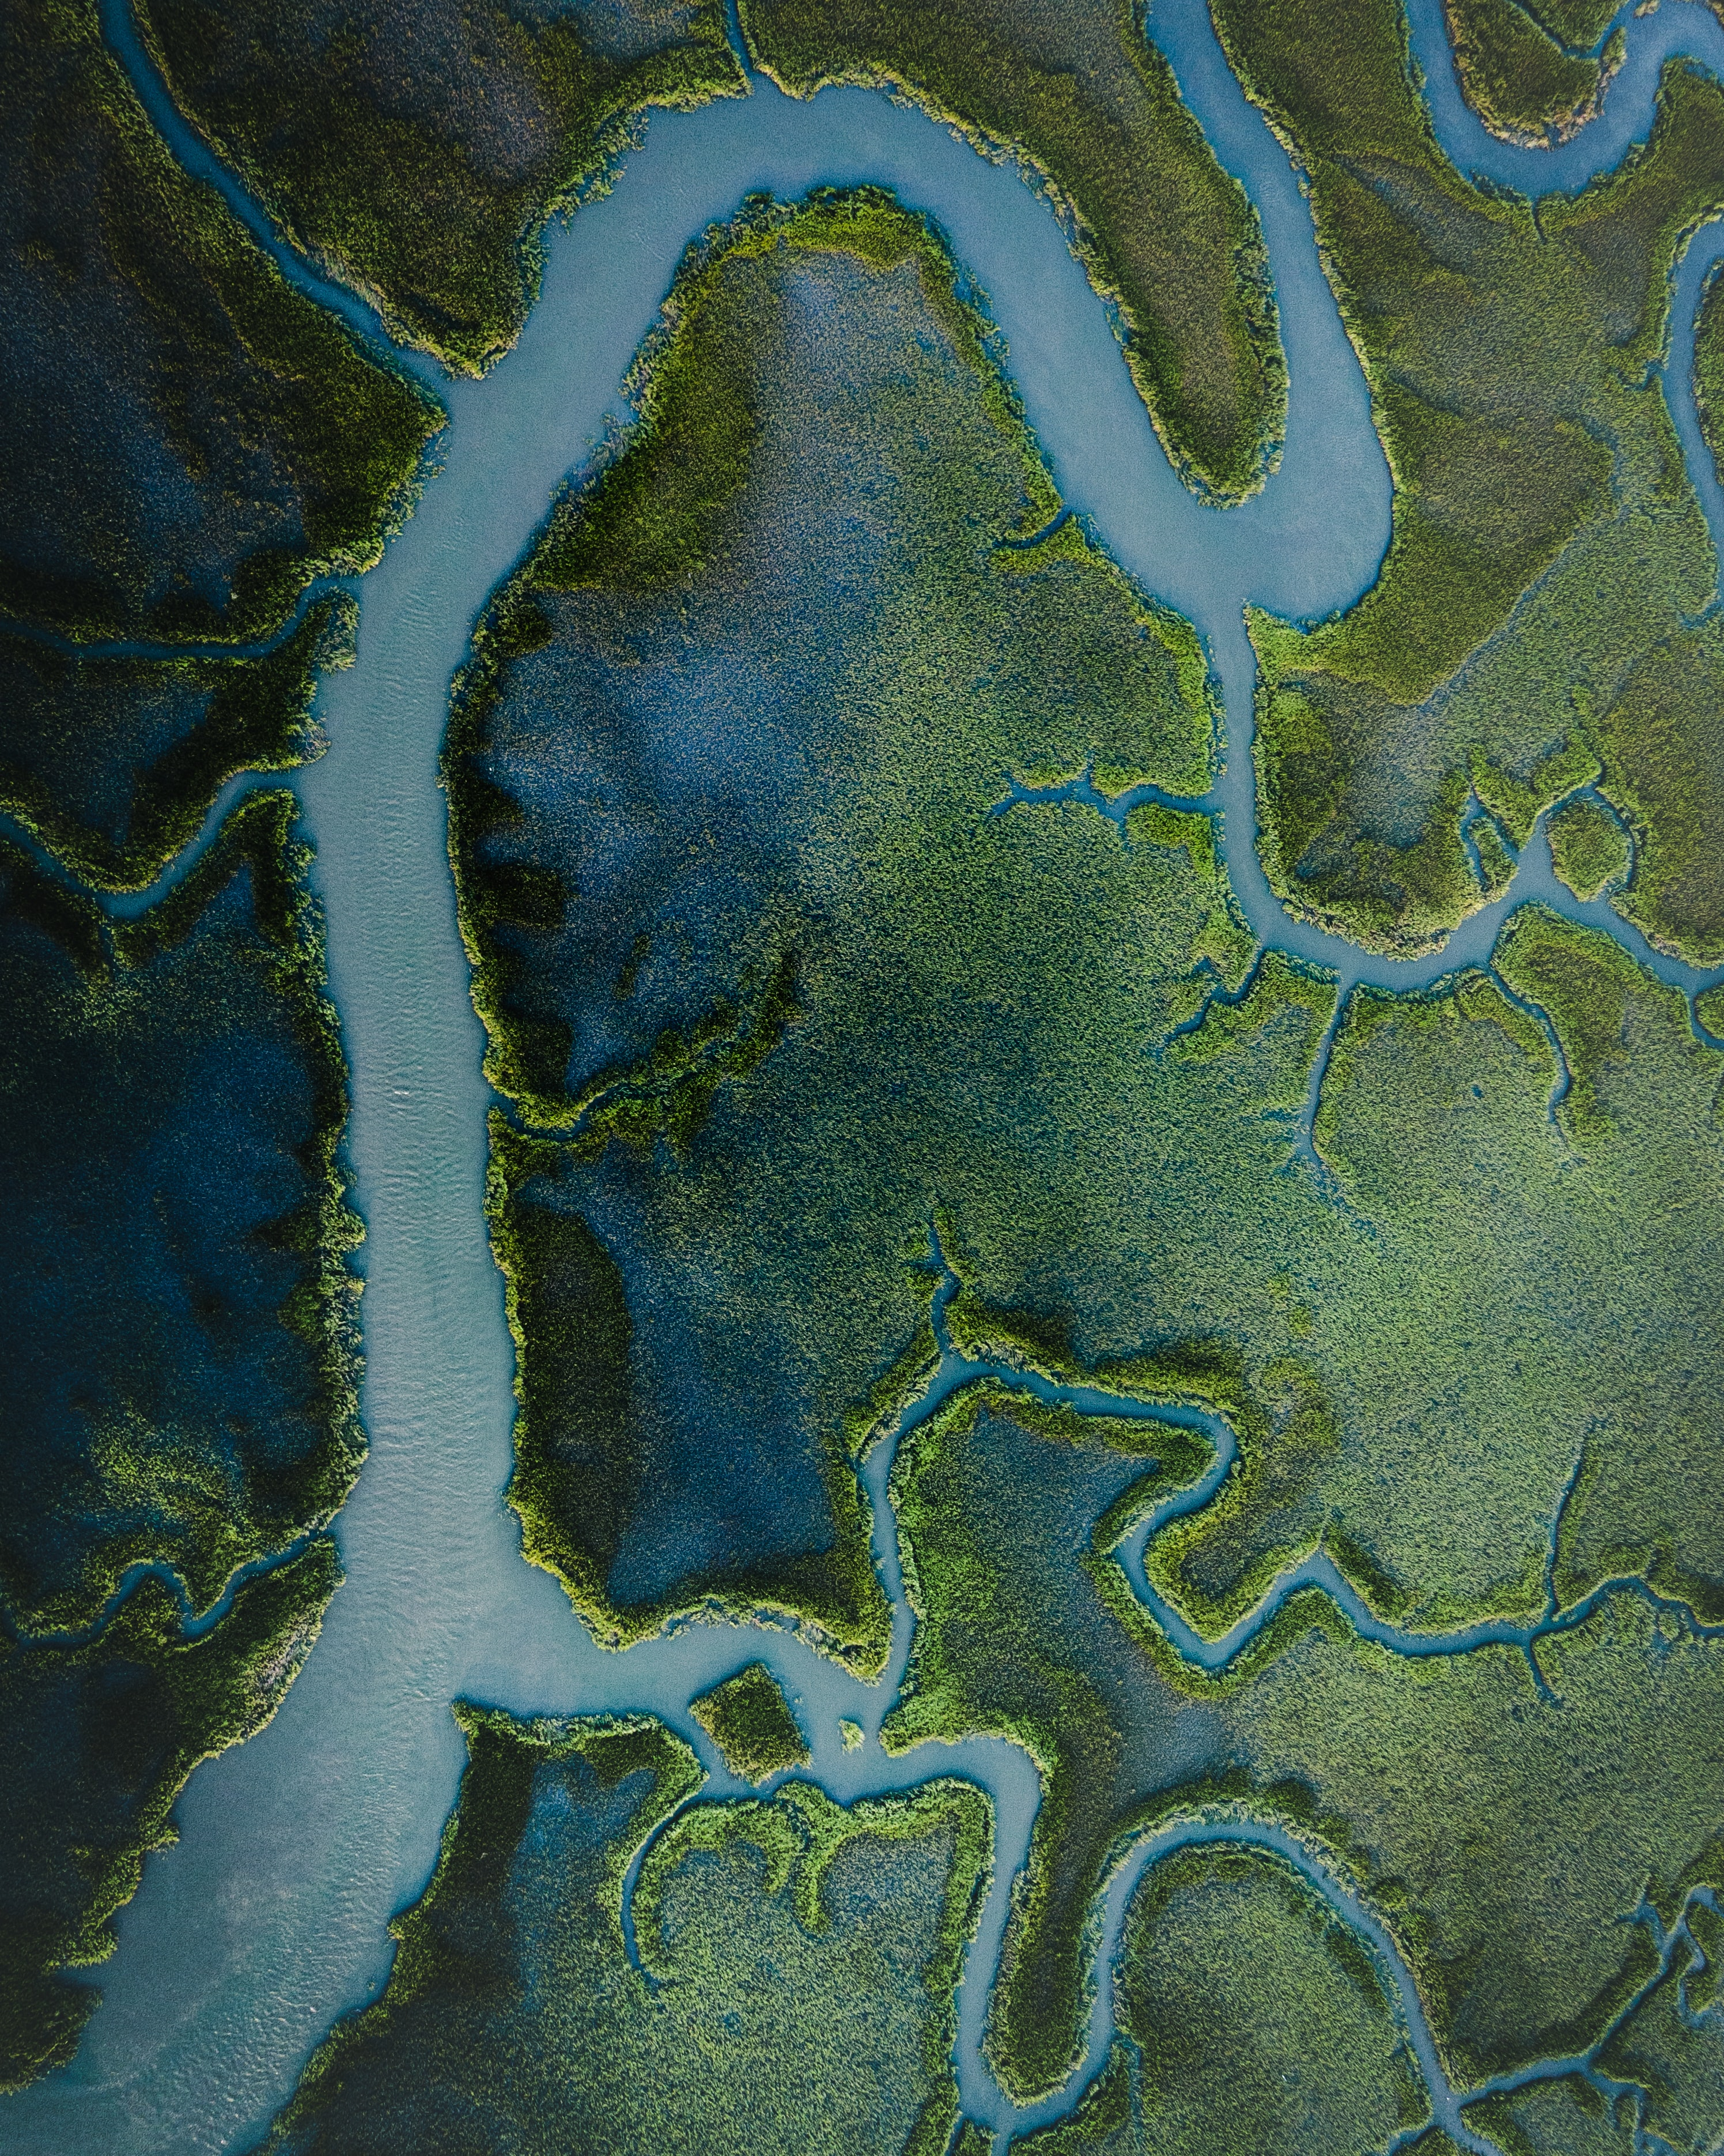
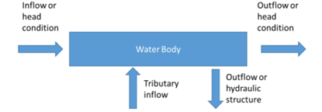
Flow
Required
Headwater
Downstream
Tributary
Withdrawals
Water surface elevations

Slide 8
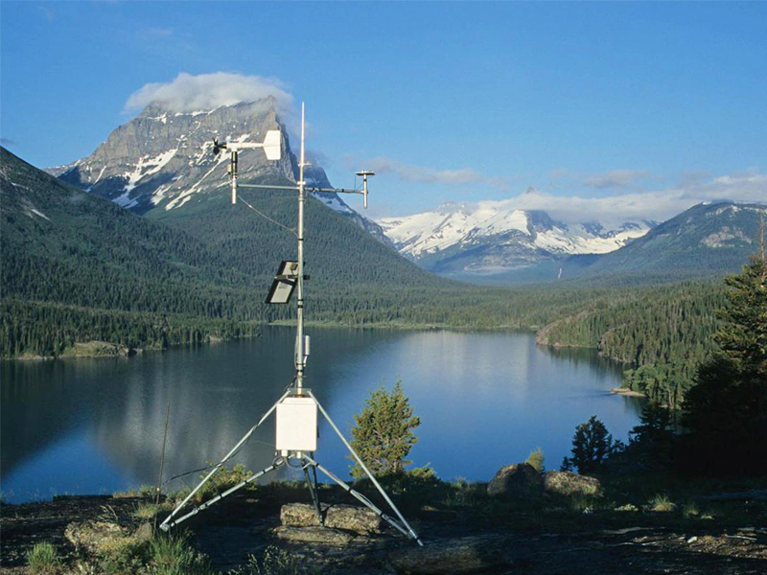
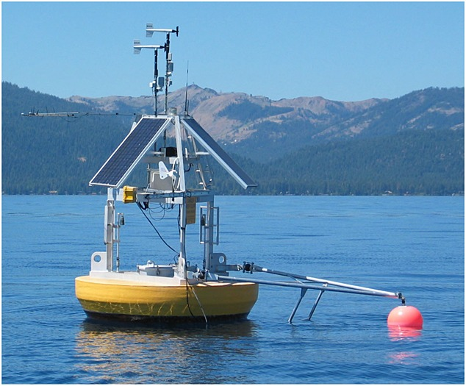
Meteorology
Reliable data is essential to model performance, accuracy of model results, and validity of any concepts developed from model.
There is no substitute for good met data.
Typical sources are airports in vicinity of project.
If available multiple airports may be used to evaluate model sensitivity.
Class A
Required information:
Air Temperature
Dew Point Temperature
Wind Speed
Wind Direction
Cloud Cover
Solar Radiation

Slide 9
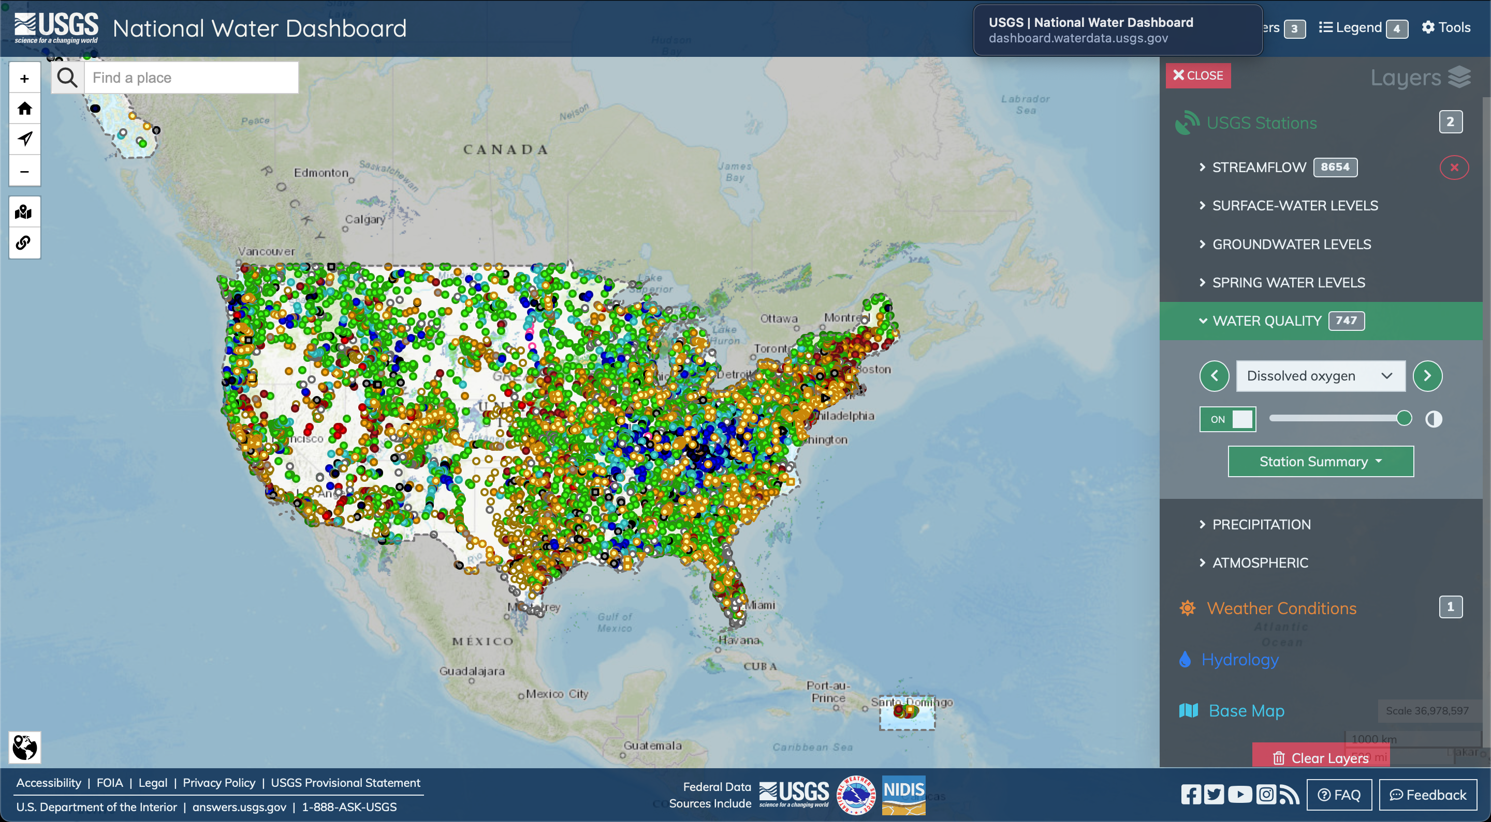
Observations
Observed data
For all water quality constituents
Provides Boundary conditions
Calibration
Analysis provides insight as to what is occurring in system PRIOR to modeling.
Aids in refinement of modeling approach.

Slide 10
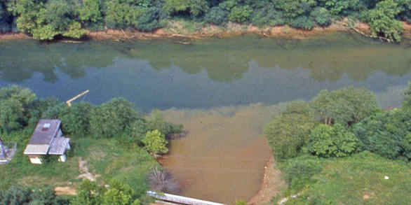
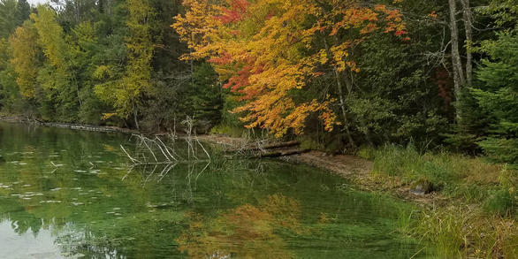
Other
Loadings
Point source
Non-point source/runoff
Other forms of water quality constituent loads
Sediment
Operations records
Which gates used for how long
Power generation
Spills
Anything else that impacts water movement

Slide 11
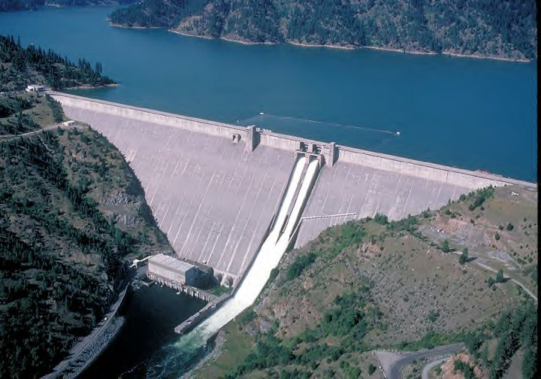

Output
Identify what information is desired from model output.
Ensure that it is being output at times and locations desired.
Process and evaluate model output and compare to applicable observations.

Slide 12
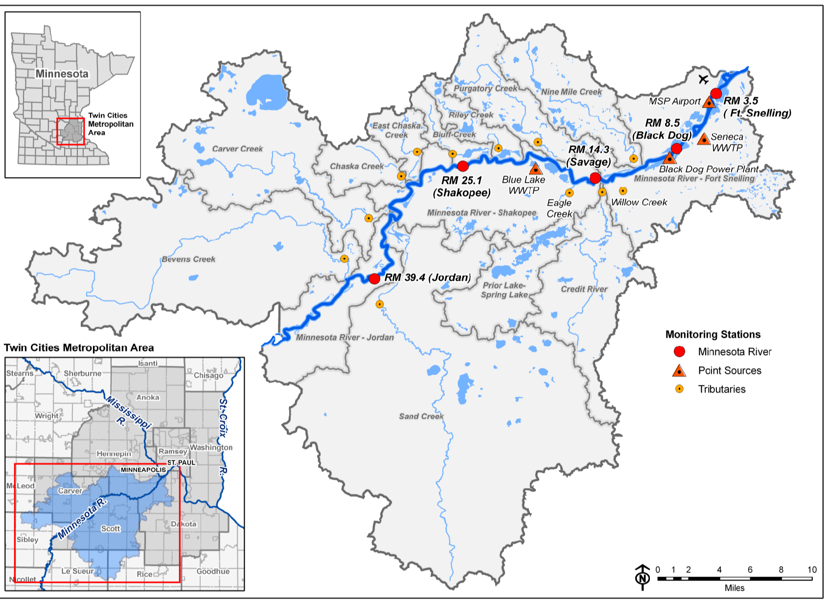
Case Study: Lower Minnesota River
Real application to Lower Minnesota River
Agricultural drainage basin
Low DO issues
RIVERINE CE-QUAL-W2 Application
Objectives
Obtain a copy of the model, and review inputs and structure
Modify model input as directed and save
Run Model
Evaluate preliminary results

Slide 13
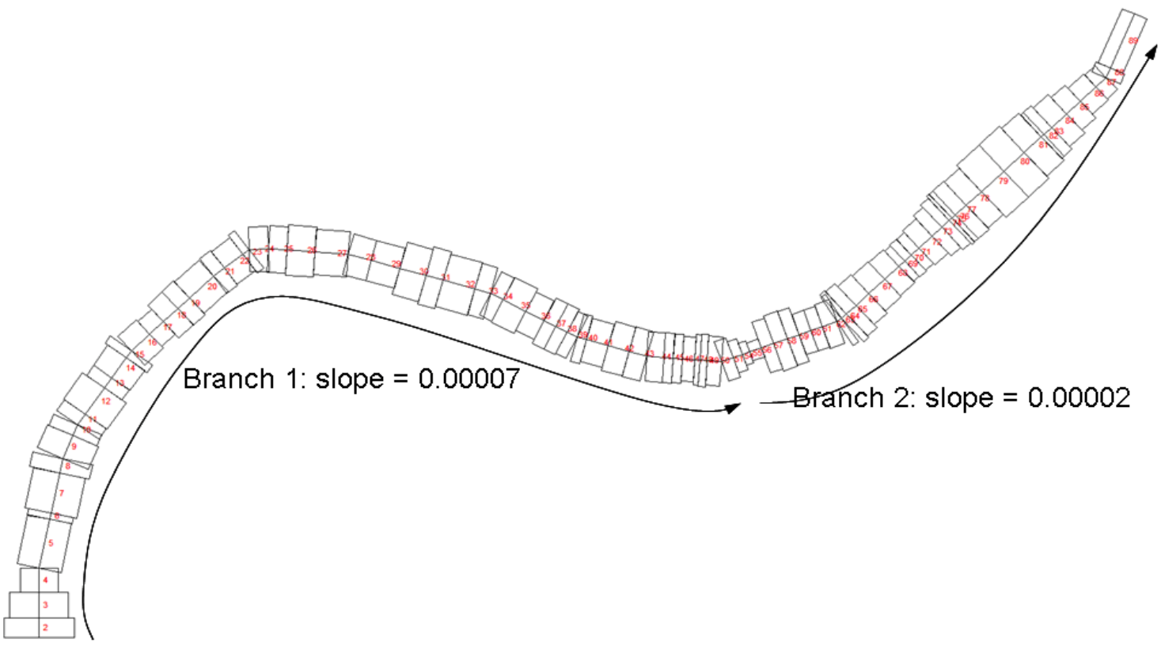
Case Study: Lower Minnesota River – CE-QUAL-W2
Original Application: CE-QUAL-W2 ver. 3.6, (Tammy Threadgill, 2016)
Important files
Bathymetry file
Boundary conditions
Flow files
Meteorological file
Control File
Each of the above may require modification/revision for application at a different time or under different conditions.
May want to work in a copy to prevent overwriting existing files

Slide 14
Bathymetry File
Typically, the bathymetry file is the first file to be developed.
Identifies the various geophysical components of model
Segment
Cross-sectional widths and heights
Bottom Elevation
Directional Orientation
Initial Water Surface Elevation
Friction
Reaches
Grouping of Segments

Slide 15
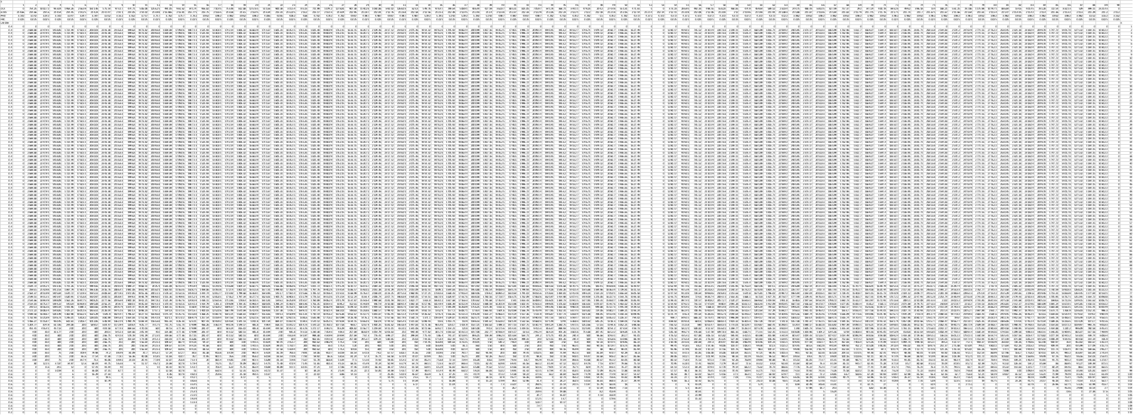
Bathymetry File: Full

Slide 16
Flow & Boundary Files
Generate Time Series files for all potential external flows entering the model
Frequency
Each requires corresponding temperature and concentration boundary conditions file
01QT355.INP
Mean daily flows, Sand Creek discharge near river mile 35.5, 10/01/00-9/30/01
Source: MCES
JDAY QIN Comment (e = estimated)
275.0 .4475
276.0 .4390
277.0 .4786
278.0 .2436
279.0 .0283
280.0 .0283
281.0 .0283

Slide 17
Temperature Boundary Condition File
Mean hourly temperature, Sand Creek to MN river mile 35.5, 10/1/00-9/30/01
Source: No measurements so estimated via regression to Nine Mile Creek
JDAY TIN Comment (e=estimated via regression)
275.0000 15.50 e regression
275.0417 15.30 e regression
275.0833 15.10 e regression
275.1250 14.90 e regression
275.1667 14.60 e regression
275.2083 14.40 e regression
275.2500 14.10 e regression
275.2917 14.00 e regression
275.3333 13.90 e regression
275.3750 14.00 e regression
275.4167 14.60 e regression
275.4583 15.20 e regression
275.5000 15.60 e regression
275.5417 16.40 e regression
275.5833 16.80 e regression
275.6250 16.80 e regression
275.6667 16.90 e regression
275.7083 16.80 e regression
275.7500 16.60 e regression
275.7917 16.40 e regression
275.8333 16.10 e regression
275.8750 15.70 e regression
275.9167 15.40 e regression
275.9583 15.20 e regression
276.0000 15.00 e regression
276.0417 14.60 e regression

Slide 18
Water Quality Boundary Condition File
01CTR_355.NPT -- Sand Creek -- RM 35.5 -- WY01
Obtained from WY01_03 WQ Tributaries_TLT_RUN06.xls; updated LTI algal splits based on latest report
BODU
JDAY TDS ISS1 PO4 NH4 NO3 DSI LDOM RDOM LPOM RPOM 1C 2C 3C 4C 5C 6C ALG1 ALG2 ALG3 DO LDOP RDOP LPOP RPOP LDON RDON LPON RPON
275.000 506.21 27.00 0.180 0.020 1.600 20.500 0.134 0.759 0.134 0.759 0.00 0.00 0.00 0.0 0.00 0.00 1.240 0.383 0.133 10.970 0.001 0.004 0.001 0.004 0.007 0.038 0.007 0.038
306.000 517.32 26.00 0.220 0.020 1.900 20.500 0.134 0.759 0.134 0.759 0.00 0.00 0.00 0.0 0.00 0.00 1.477 0.209 0.069 11.840 0.001 0.004 0.001 0.004 0.007 0.038 0.007 0.038
336.000 515.49 28.00 0.210 0.030 2.000 20.500 0.134 0.759 0.134 0.759 0.00 0.00 0.00 0.0 0.00 0.00 1.730 0.008 0.008 14.600 0.001 0.004 0.001 0.004 0.007 0.038 0.007 0.038
367.000 527.66 27.00 0.240 0.420 2.300 20.500 0.129 0.729 0.129 0.729 0.00 0.00 0.00 0.0 0.00 0.00 1.636 0.010 0.102 14.830 0.001 0.004 0.001 0.004 0.006 0.036 0.006 0.036
398.000 515.49 28.00 0.210 0.020 2.000 20.500 0.134 0.759 0.134 0.759 0.00 0.00 0.00 0.0 0.00 0.00 1.297 0.069 0.389 14.830 0.001 0.004 0.001 0.004 0.007 0.038 0.007 0.038
426.000 517.00 27.00 0.210 0.940 2.100 20.500 0.134 0.759 0.134 0.759 0.00 0.00 0.00 0.0 0.00 0.00 1.087 0.078 0.589 14.830 0.001 0.004 0.001 0.004 0.007 0.038 0.007 0.038
457.000 328.06 205.00 0.170 0.180 6.100 19.100 0.193 1.093 0.193 1.093 0.00 0.00 0.00 0.0 0.00 0.00 2.853 0.048 0.609 14.830 0.001 0.005 0.001 0.005 0.010 0.055 0.010 0.055
487.000 347.37 146.00 0.170 0.040 5.400 19.100 0.171 0.971 0.171 0.971 0.00 0.00 0.00 0.0 0.00 0.00 3.309 0.075 0.126 10.970 0.001 0.005 0.001 0.005 0.009 0.049 0.009 0.049
518.000 372.39 206.00 0.200 0.030 6.200 19.000 0.188 1.063 0.188 1.063 0.00 0.00 0.00 0.0 0.00 0.00 3.019 0.175 0.248 10.470 0.001 0.005 0.001 0.005 0.009 0.053 0.009 0.053
548.000 447.64 70.00 0.190 0.030 2.600 19.700 0.150 0.850 0.150 0.850 0.00 0.00 0.00 0.0 0.00 0.00 1.936 0.301 0.193 8.600 0.001 0.004 0.001 0.004 0.008 0.043 0.008 0.043
579.000 507.94 27.00 0.200 0.020 1.900 20.500 0.134 0.759 0.134 0.759 0.00 0.00 0.00 0.0 0.00 0.00 1.432 0.200 0.123 8.550 0.001 0.004 0.001 0.004 0.007 0.038 0.007 0.038
610.000 499.23 25.00 0.200 0.020 1.800 20.500 0.134 0.759 0.134 0.759 0.00 0.00 0.00 0.0 0.00 0.00 1.440 0.192 0.123 9.700 0.001 0.004 0.001 0.004 0.007 0.038 0.007 0.038
641.000 513.58 25.00 0.200 0.020 1.900 20.500 0.112 0.633 0.514 2.913 0.00 0.00 0.00 0.0 0.00 0.00 1.247 0.376 0.132 11.360 0.001 0.003 0.003 0.015 0.006 0.032 0.026 0.146

Slide 19
Meteorological File
Hourly (plus) meteorological data, MSP Intl Airport near river mi 3; updated 06/01/2009
Source: MDNR except solar from UM, St. Paul Campus; TLT added cloud cover from 14WS
JDAY TAIR TDEW WIND PHI CLOUD SRO
275.000 23.900 10.000 3.600 2.600 8.0 0.000
275.037 22.800 8.900 5.100 2.600 8.3 0.000
275.079 22.800 8.900 6.200 3.000 8.6 0.000
275.120 22.200 8.900 6.700 3.100 8.9 0.000
275.162 21.100 9.400 6.700 3.500 9.1 0.000
275.204 21.700 9.400 7.700 3.700 9.4 0.000
275.245 21.100 8.900 5.700 3.700 9.7 0.000
275.250 21.100 9.400 6.200 3.700 10.0 23.012
275.287 20.000 10.000 6.200 3.700 9.9 23.012
275.329 18.900 10.000 5.100 3.700 9.7 88.560
275.370 17.200 10.000 3.600 3.700 9.6 128.307
275.412 16.100 10.000 1.500 3.050 9.4 355.633
275.454 14.400 10.000 3.600 2.400 9.3 433.733
275.495 13.900 10.000 3.100 2.300 9.1 278.231
275.500 14.400 10.000 3.100 2.300 9.0 370.974
275.537 13.900 10.600 3.100 2.400 9.0 370.974
275.579 15.000 10.600 3.100 2.600 9.0 175.725
275.620 16.100 10.600 4.100 3.100 9.0 149.924
275.662 18.300 11.100 4.100 2.600 9.0 56.483
275.704 20.000 11.100 4.600 3.000 9.0 28.590
275.745 21.100 11.100 3.050 2.720 9.0 9.763
275.750 20.600 11.100 1.500 2.440 9.0 0.000
275.787 22.200 11.700 3.100 2.160 9.0 0.000
275.829 22.200 11.700 0.000 1.880 9.0 0.000
275.870 23.300 11.700 5.100 1.600 9.0 0.000
275.912 22.200 11.700 2.600 3.000 9.0 0.000
275.954 22.800 11.700 2.600 1.950 9.0 0.000
275.995 22.200 12.200 3.600 0.900 9.0 0.000
276.000 21.700 12.200 3.600 0.900 9.0 0.000
One file
Daily or more frequent, depending upon issues
Important to capturing what is happening “in” the model at a given time

Slide 20
Control File
This file contains specifications of much of the information that controls model operation

Slide 21
After Model is Initially Set Up
Run the W2 preprocessor
Address what Errors the pre-processor identifies.
Once addressed, re-run W2 pre-processor, and continue until there are no Errors.
Evaluate Warnings to see if they warrant changes or modifications.
Compare computed Volume Elevation curve to official curve if available.
If results are not satisfactory, adjust the bathymetry, and start the process again.

Slide 22
After W2 Preprocessor is Finished
Run CE-QUAL-W2 model
Review model output
“w2.wrn” file
Time Series files
Evaluate model performance.
Did it appear to operate as you desired?
Address issues that develop……..

Slide 23
Exercises: Model Simulation 1
Short Duration Simulation:
Modify W2 Control file to adjust model simulation duration to 3 months (90 days).
Adjust model time step in W2 Control file by changing DLTMIN from 0.1 to 1.
Change NDLT from 7 to 1.
Try different schemes.
NDLT | DLTMIN
7 | 0.1
TRANSPORT SCHEME | WB1
SLTRC - UPWIND, QUICKEST, ULTIMATE - use ULTIMATE | ULTIMATE
THETA - degree of implicitness - use 0.55 - Time-weighting for vertical advection scheme | 0.5
HYD COEFFICIENTS | WB1
AX - Longitudinal eddy viscosity, m2/s | 1
DX - Longitudinal eddy diffusivity/conductivity, m2/s | 1

Slide 24
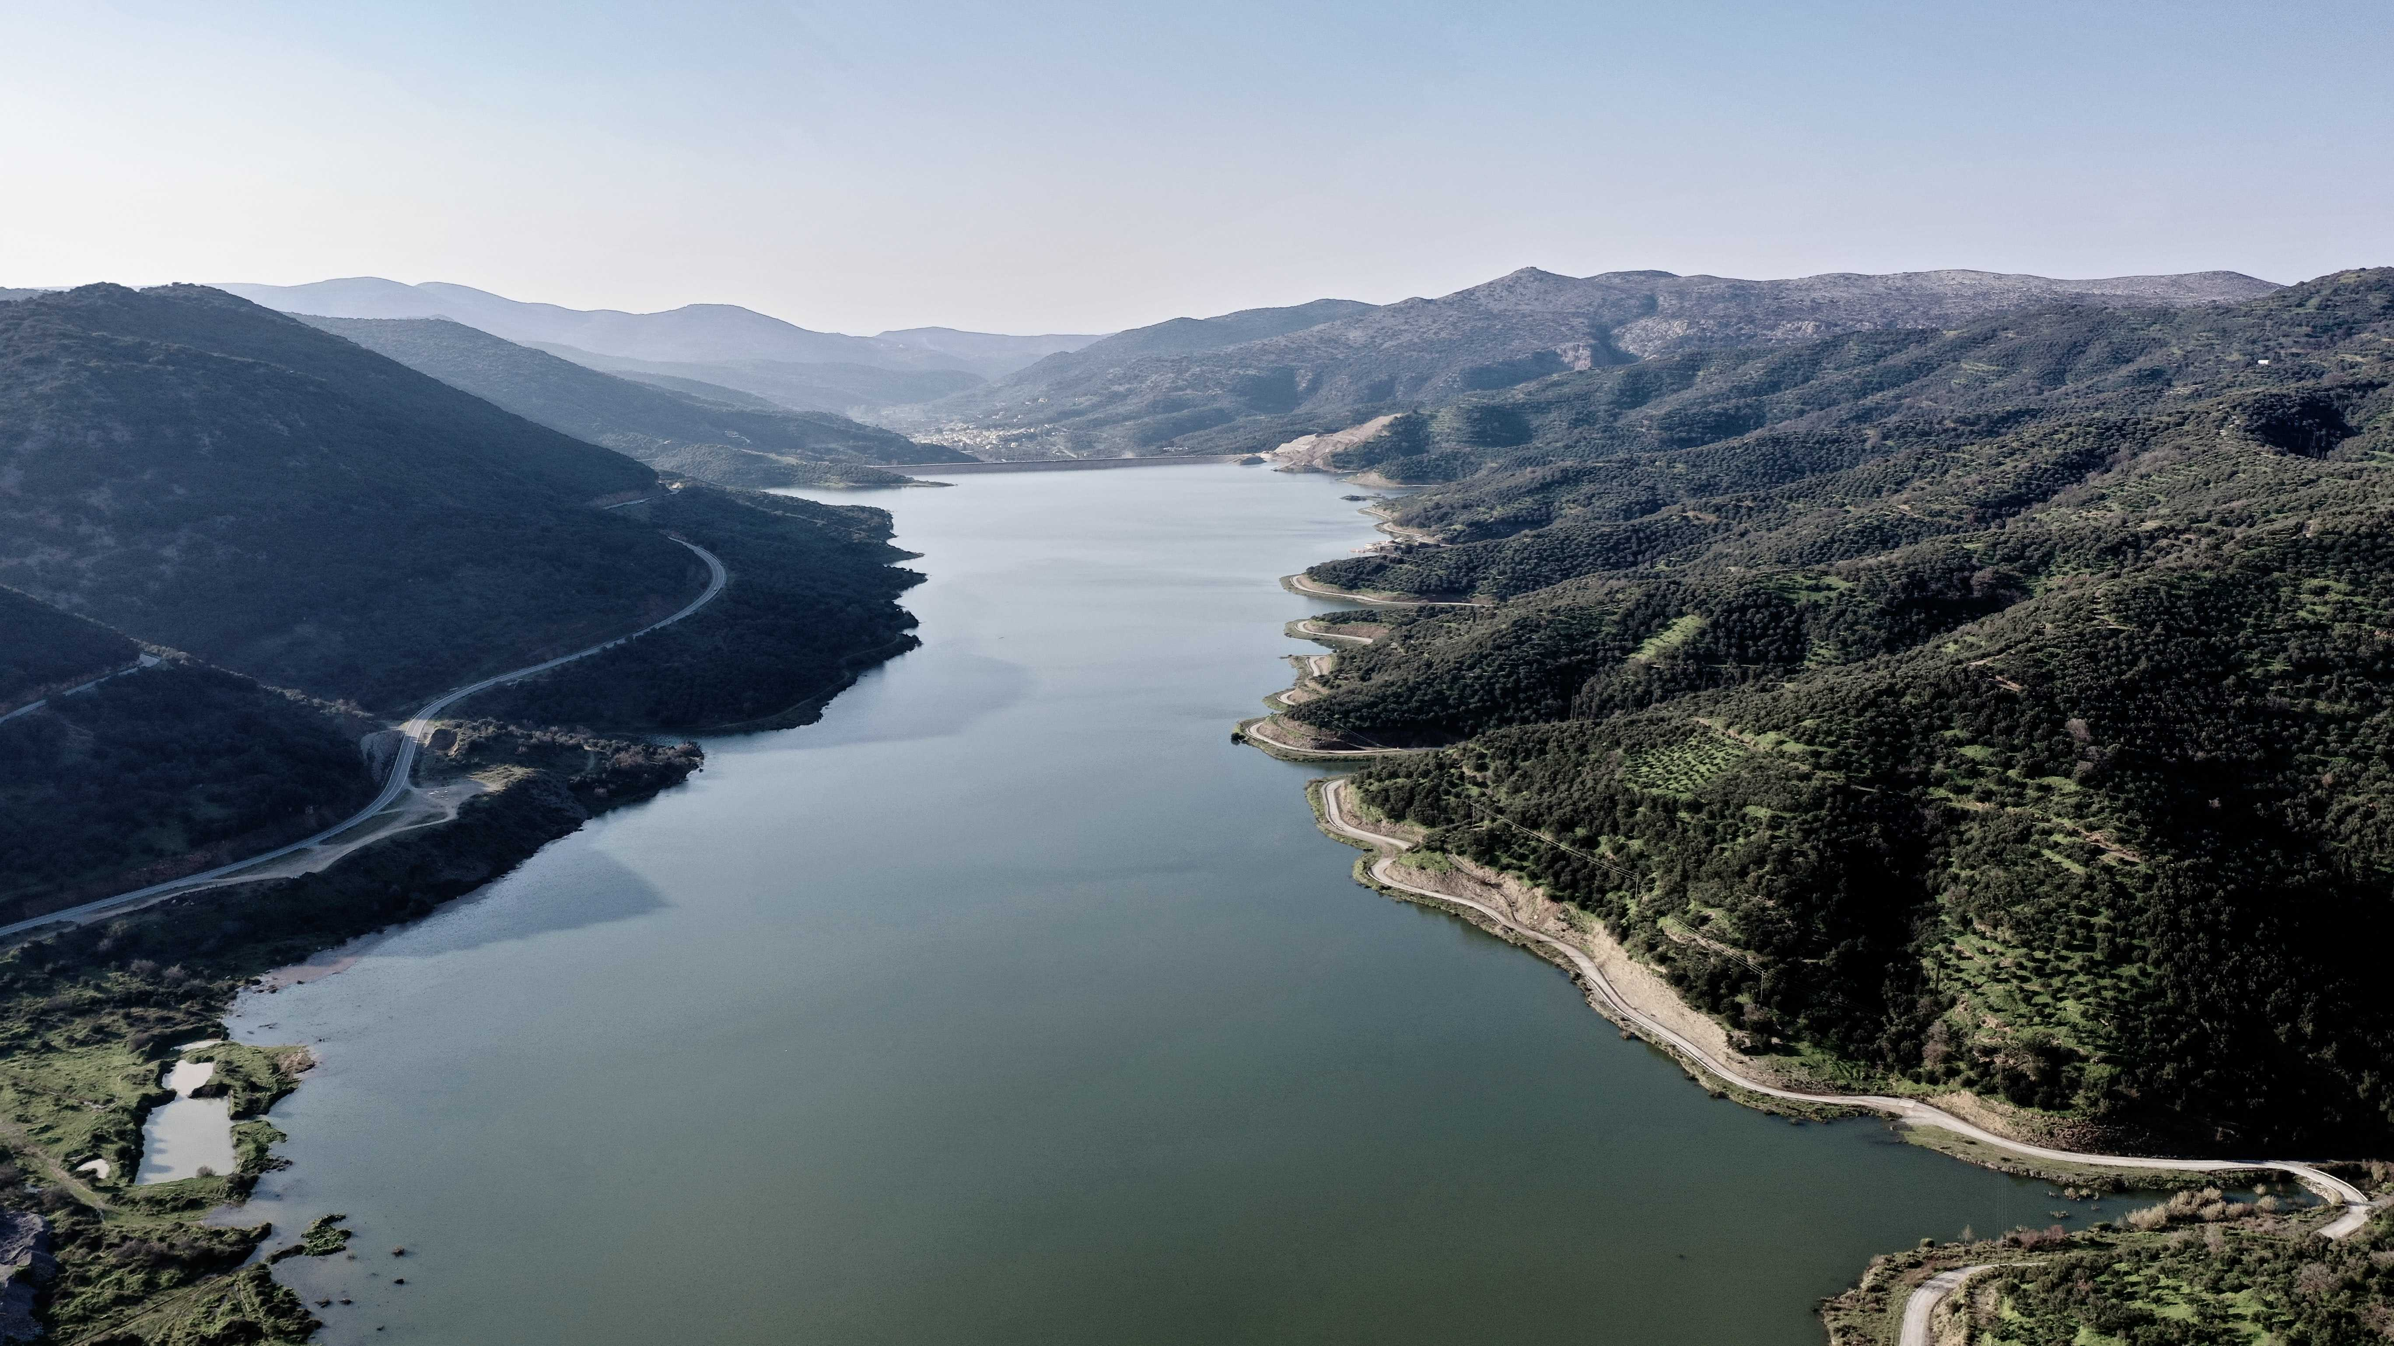
Questions?

